Slide 1
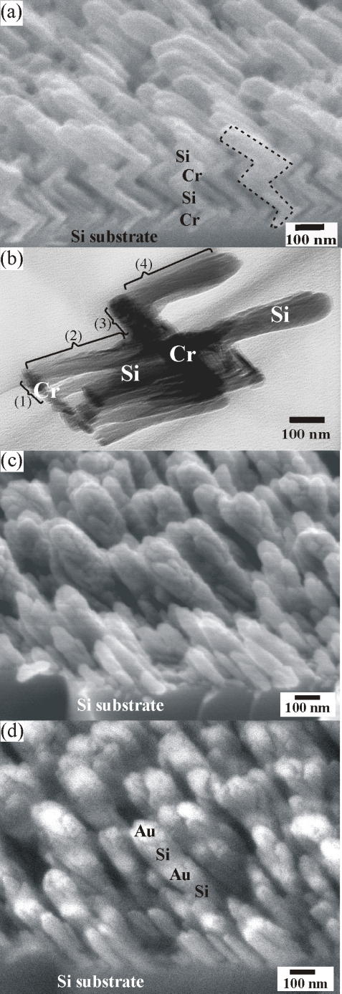
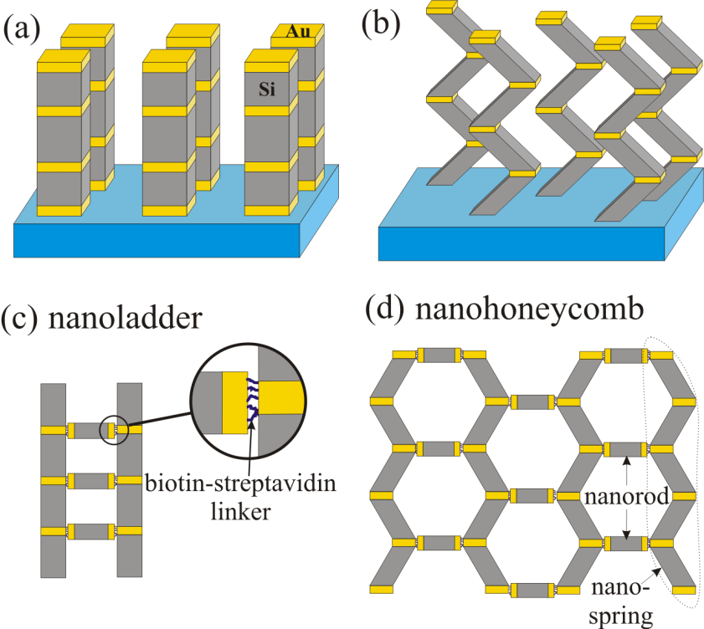
Growth of nanopillar arrays for directed bio-molecule assembly
PRF# 44226 -G10
Daniel Gall,
Department of Materials Science and Engineering, Rensselaer Polytechnic Institute
This project explores a completely new approach to build complex hierarchical nano-to-meso-scale architectures by growing 20-200 nm wide nanopillars and nanosprings by glancing angle deposition (GLAD) and directing their assembly into complex hybrid architectures using biological connector molecules.
Left: Multi-component nanostructures grown by GLAD. (a) Secondary electron image of Cr-Si zigzag nanosprings, (b) transmission electron micrograph of Cr-Si nanosprings, with the four arm levels labeled (1)–(4), (c) secondary electron image of Si-Au nanorods, and (d) back-scattered electron image of Si-Au nanorods.
Right: Schematic of multi-component (a) nanorods and (b) nanosprings grown by glancing angle deposition. The hierarchical assembly of these nanostructures into complex shapes like (c) nanoladders and (d) nanohoneycombs, using biotin-streptavidin connectors.

