Slide 1
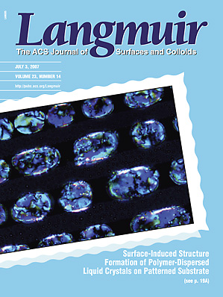
Phase Separation Kinetics of Polymer Dispersed Liquid Crystals (PDLC) on a Chemically Heterogeneous Substrate
Polarized optical micrograph of the formation of ordered, “Gem Bracelet” like 5CB domains in the polystyrene/5CB film.^{1, 2}
The CN stretch peak (i.e., at 2228 cm⁻¹) intensity of the PS/5CB film on the Au-rings-patterned ITO substrate.²
1. J. Wang et al, Science as Art competition at the 2007 Spring MRS meeting in San Francisco (finalist)
2. J. Wang, J. Xia, and S.W. Hong et al. Langmuir, 23, 7411 (2007)

